Slide 1

Hate Speech Detection on Twitter Data
Group-11:
Sriraksha Govinda Reddy (1139863), Leonard Michael Gomes Dip (1138452), Desiree Mary Dmello (1137433),
Utsav Narendra Panchal (1142809), Rudra Ravidutt Saxena (1148251)
Guided By: Dr. Amine Trabelsi

Slide 2
Problem Statement
As a consequence of social media platforms, a wide range of ideas have been shared by the general public, leading to real-time sharing of thoughts, as well as a rise in hate speech, abuse, and bullying.
Our research aims to identify hate speech remarks or comments on the internet using methodologies that include hate speech detection tools, libraries, and classifier algorithms to determine whether or not a particular statement contains hate speech.

Slide 3
Related work
(Bouazizi and Otsuki Ohtsuki, 2016) in their works have utilized tweets from Twitter by performing machine learning classification through manually extracting various features for detecting sarcastic responses.
(Yin W) proposed a combination of LSTM-GRU (Unique Gating Design of LSTM) in their paper to achieve much better accuracy and performance speed in comparison to RNN (Recurrent Neural Network), LSTM (Long Short-Term Memory Network), and GRU (Gate Recurrent Unit) models.

Slide 4
Motivation and Challenges
To identify hateful and damaging remarks on social media sites such as Twitter, and to detect and remove such comments in a timely way.
Machines are unable to recognize sarcasm in the same way that people do, which resulted in certain comments being flagged as hateful, although particular phrases in the provided remark were not intended to be cruel.

Slide 5

Methodology
Data Preprocessing : Stemming and Lemmatization
TF-IDF & Bag of Words
RNN & GRU

Slide 6
Data Preprocessing
Dataset utilized for this project is fetched from kaggle twitter dataset.
Problem dataset comprises of a training dataset (113133 labeled texts). Final dataset includes target and text.
Every text input is labeled as 0 or 1, depending on whether hate speech or not, and rated with the offensiveness score (0-1). 0 indicates positive and 1 indicates Negative.
For cleaning we removed stopwords and unnecessary notation.
lemmatizing, stemming and tokenization.

Slide 7
Bag of Words and TF-IDF
Bag of words
TF-IDF (Term Frequency - Inverse Document Frequency)
Text Classification Models- Logistic Regression, Support Vector Machine (SVM), Naive Bayes Model and Random Forest.
Evaluation of performance- Accuracy, Precision, Recall rate and F1 score

Slide 8
GRU
Data cleaning
Word Embedding [Glove.twitter.27B.200d.txt]
We using Recurrent Neural network (RNN) and Gated recurrent unit (GRU).
Activation function we used Relu and sigmoid
Dropout layer
Optimizer is Adam

Slide 9

Results
Accuracy Comparison of Models
Training And Testing Accuracy of GRU Model
Prediction Accuracy

Slide 10
We are showing a report on precision, recall, f1-score, and accuracy, and made the comparison table of the TF-IDF methods with the accuracy.
Logistic Regression algorithm performed well in terms of the time taken and testing accuracy and Stochastic Gradient Descent, SVM, and Naive Bayes also showed almost similar accuracy but took longer time .
In comparison, we used Bag of Words method where Logistic Regression algorithm performed better than the other algorithms.
The prediction accuracy is 72% which compared to the traditional models is relatively lower. The training accuracy showed the data as overfilling.

Slide 11
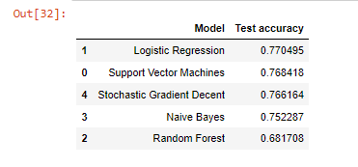
Comparison of Models
Model | Test Accuracy
Logistic Regression | 77%
Support Vector Machine | 77%
Naive Bayes | 70%
Random Forest | 69%
Fig 1. Accuracy Comparison in TF- IDF Approach
Table 1. Accuracy comparison using Bag of Words

Slide 12
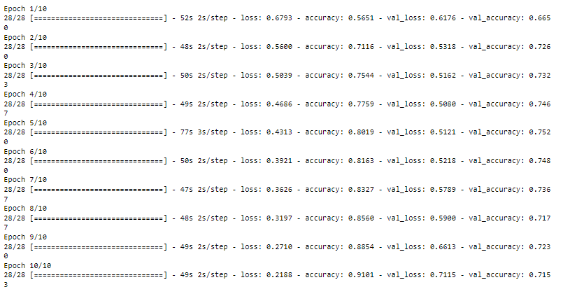
Training And Testing Accuracy of GRU Model
Fig 3. Testing Accuracy of GRU Model
Fig 2. Training Accuracy of GRU Model

Slide 13
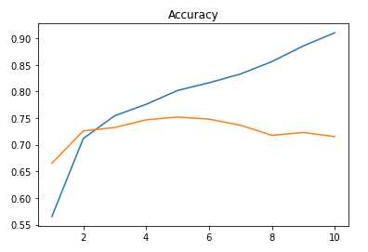
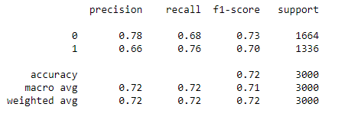
Prediction Accuracy
Fig 5. Prediction Accuracy
Fig 4. Accuracy Curve of GRU

Slide 14
Limitations
Processing time due to system limitations.
Large dataset resulted in slower computation of preprocessing the data.
Working on achieving better model accuracy in GRU

Slide 15
Future Work
To automate the process for eliminating hate speech or flagging them down as inappropriate.
Inclusion of Bi-LSTM model.
Including graphical indication of performance and accuracy of model.

Slide 16
Thank you!

Slide 17
Contributions
Literature Review : Everybody
Dataset Research : Rudra, Utsav, Raksha
Data Pre-processing : Utsav, Rudra
Data Cleaning : Michael, Desiree, raksha
Model Analysis : Michael, Desiree
Result Analysis : Everybody
Final Report : Everybody

